Slide 1



Slide 2
Table of Contents
Overview
Life Cycle
Database Design
Chekkup Stages
Schedule
Charts
Schedule
Appointments
Patients
Charts
Events
PMH
Dx History
Rx History
Allergies
Immunization
Lab Result
Adv Directives
Life Style

Slide 3
Chekkup Overview
Chekkup is a pure cloud based electronic health record (EHR) and a practice management software.
It addresses the complexities and critical needs of today's health care environment.
The system includes various features including appointment creation and scheduling, medical charting, e-prescription, online referrals and messaging.

Slide 4
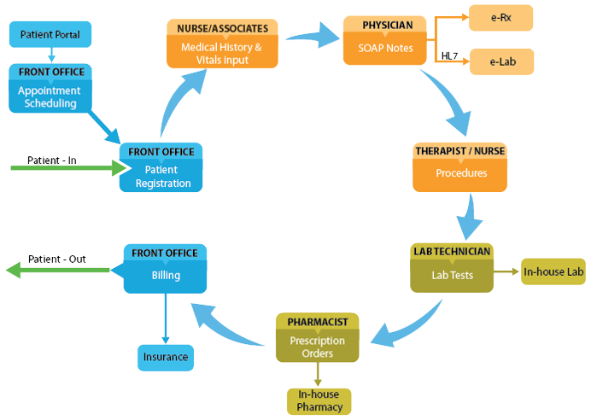
Chekkup Life Cycle

Slide 5
Functional Architecture? To be deleted
InstaKare
ProAct
Clevemed
(Clinical Diagnostics)
Fulfillment Modules
Checkkup (Restructure Project)
CRM
EHR
PMS
Workflow Engine
RCM

Slide 6
Functional Architecture
Chekkup
ProAct
Clevemed
(Clinical Diagnostics)
Fulfillment Modules
EHR
PMS
CRM
Workflow Engine
InstaKare
RCM

Slide 7
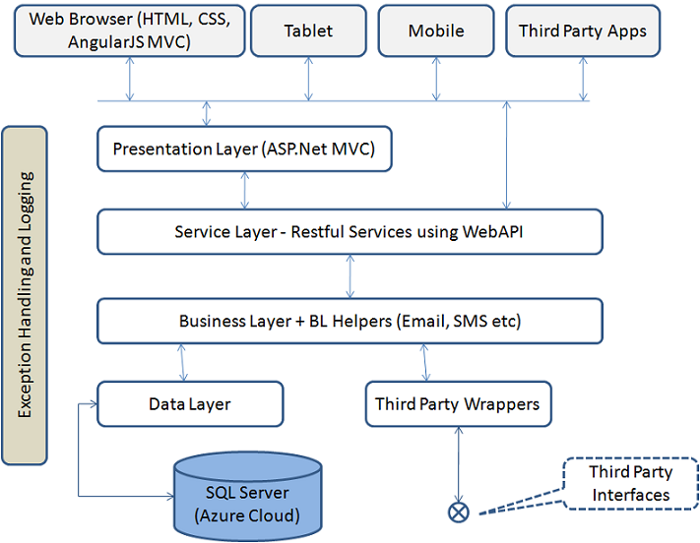
Technical Architecture? To be deleted

Slide 8
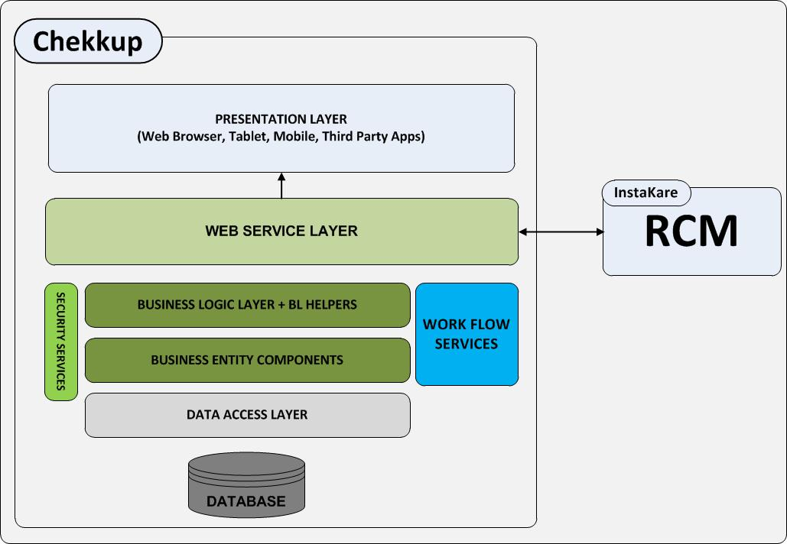
Technical Architecture

Slide 9
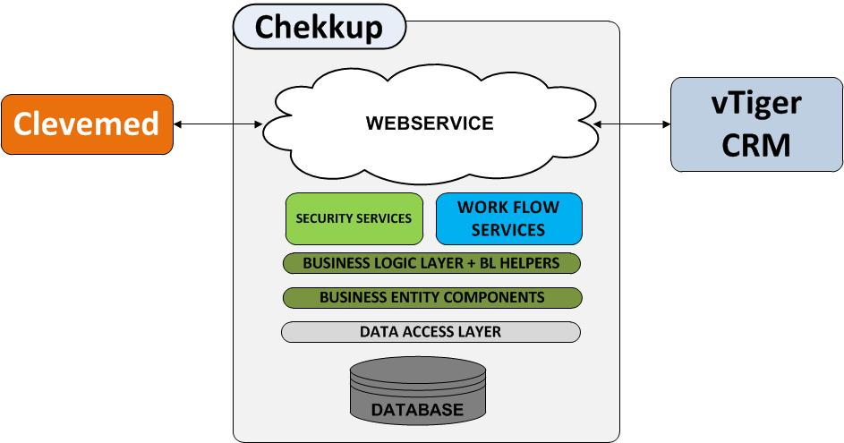
Technical Architecture

Slide 10
Chekkup re-engineering release plan
Release 1
E-H-R & PMS - Chekkup RCM – Instacare
Complete
Release 2
E-H-R, PMS Screens 15/April
Release 3
Modernize RCM -Instacare 15/June
Release 4 2-months for requirements for Chronic Disease workflow + Claims data mining module + Analytics
Integration with ProAct

Slide 11
Stage 12
Integration Testing and Bug Fixing
Stage 11
Development Stage /Reporting & Billing
Stage 10
Development Stage /Documents
Stage 8
Development Stage /Messages
Stage 9
Development Stage /Labs
Stage 7
Development Stage /eRx
Stage 6
Development Stage /Charts
Stage 5
Stage 4
Stage 3
Stage 2
Stage 1
Stage 1 - 22/July/2013
Stage 2 - 02/September/2013
Stage 3 - 15/October/2014
Stage 4 - 31/December/2014
Stage 5 - 1/January/2014
Stage 6 - 16/January/2014
Stage 7 - 02/February/2014
Stage 8 - 5/March/2014
Stage 9 - 26/February/2014
Stage 10- 10/March/2014
Stage 11 - 24/March/2014
Stage 12 - 10/April/2014
Development Stage / Appointment Schedule
Development Stage / Patient Management
Development Stage / Practice configuration
Design Stage / Visual Design / Database
Planning/Project Initiation Document

Slide 12
Delivery Dealerships

Slide 13
Team Structure
Architecture
Vinoo Thomas
Varun Nelson
DBA
Ramachandran C
Ratheesh
HTML
Sarath Daniel
Ashar Mohammed

Slide 14
Technology Stack
ASP.NET 4.0
Ajax
MVC 4.0
WCF
Windows Service
IIS 7.5
Ms Sql Server 2008 r2
Windows Azure
Windows 2008 r2

Slide 15
Partnerships

Slide 16
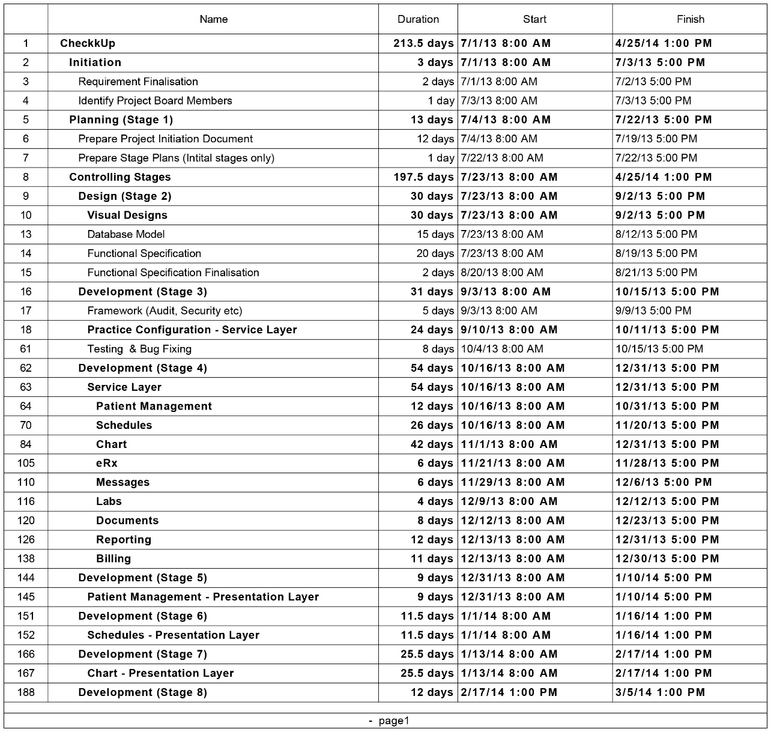
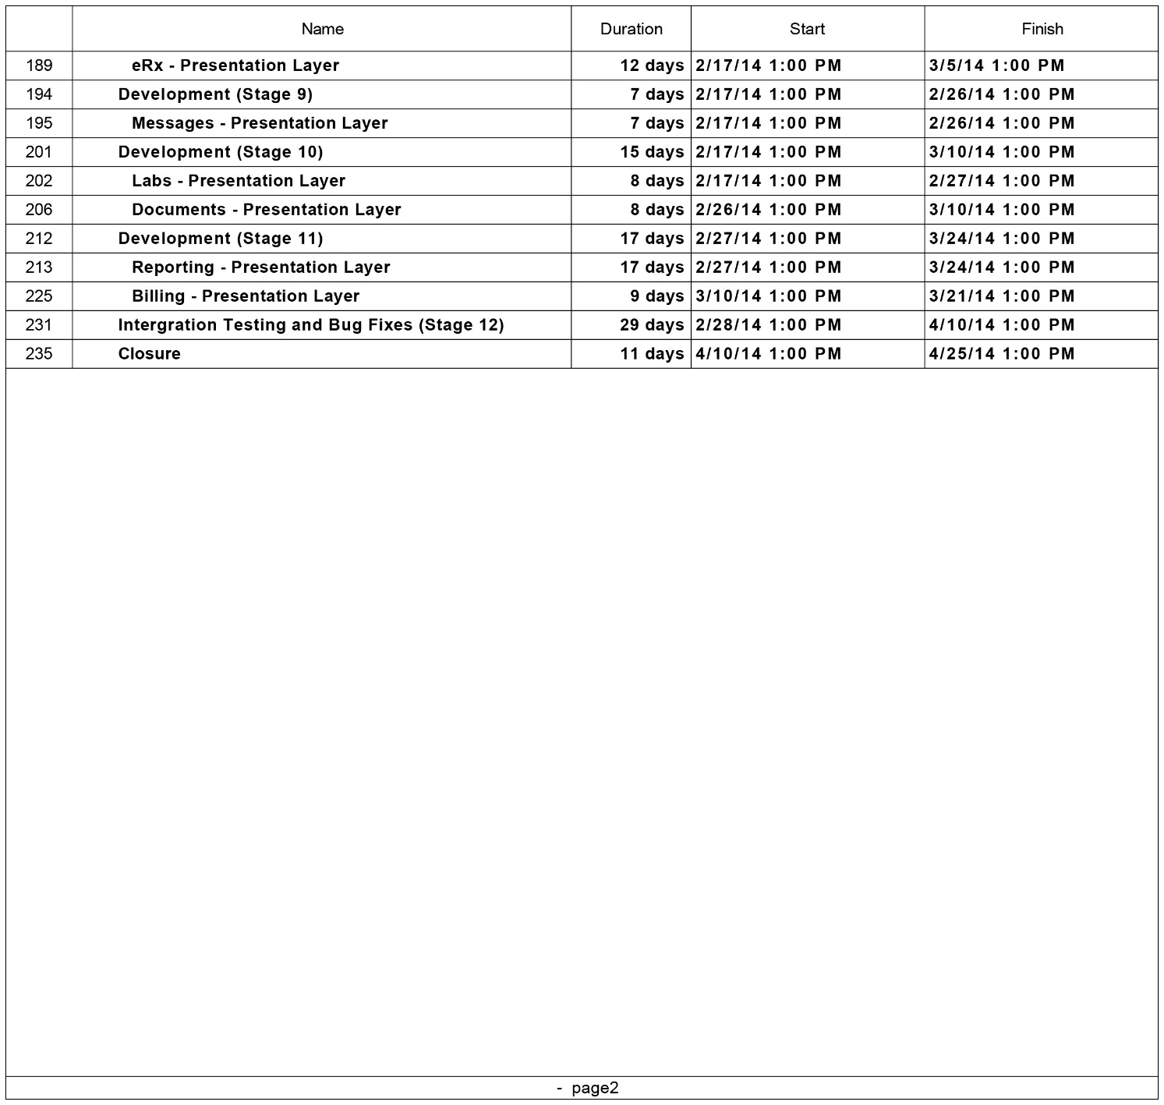
Chekkup Project Plan
View PDF

Slide 17
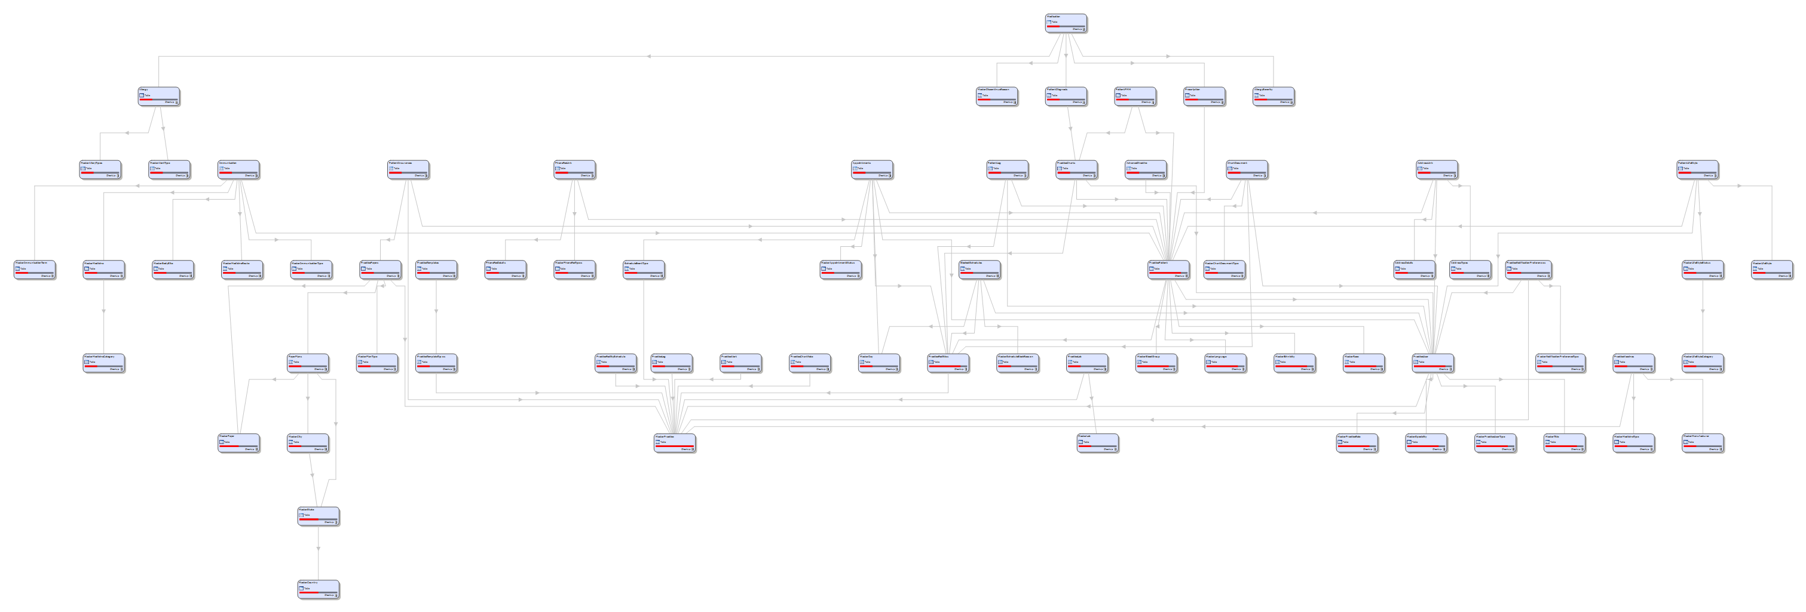
Chekkup Database Design
View Database Tables

Slide 18
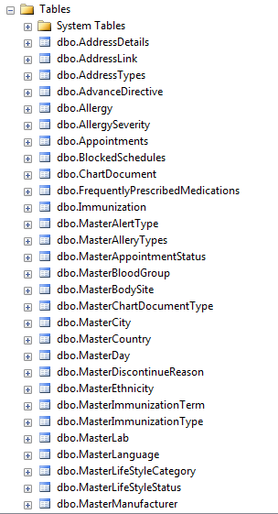
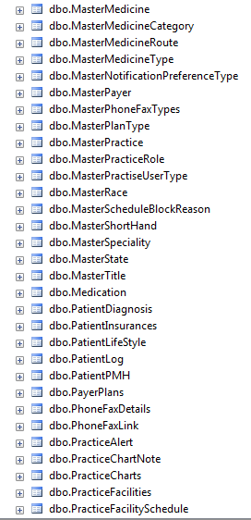
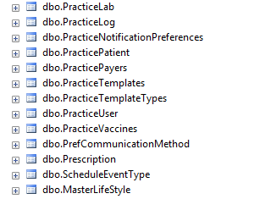
Chekkup Database Tables
Chekkup Stages

Slide 19
Chekkup Stages
Following are the two different stages in Chekkup,
Schedule
Charts

Slide 20
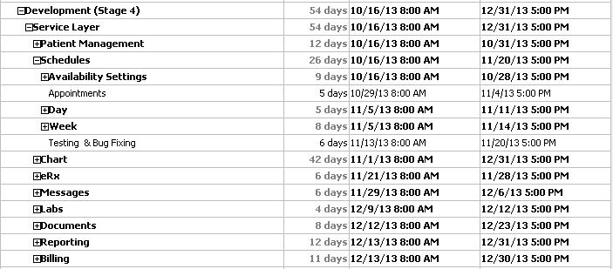
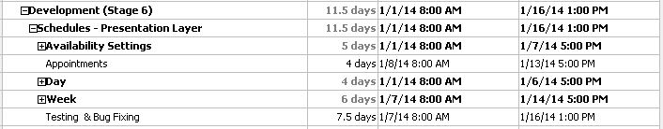
Chekkup Stages 1 – Schedule - Plan
#Stages
Service Layer Plan
Presentation Layer Plan

Slide 21
Chekkup Stages 1 - Schedule
#Stages
Schedule patient visits in a way that fits your practice size and workflow, with easy customization and multiple view options.
List Appointments
Add/Edit Patients

Slide 22
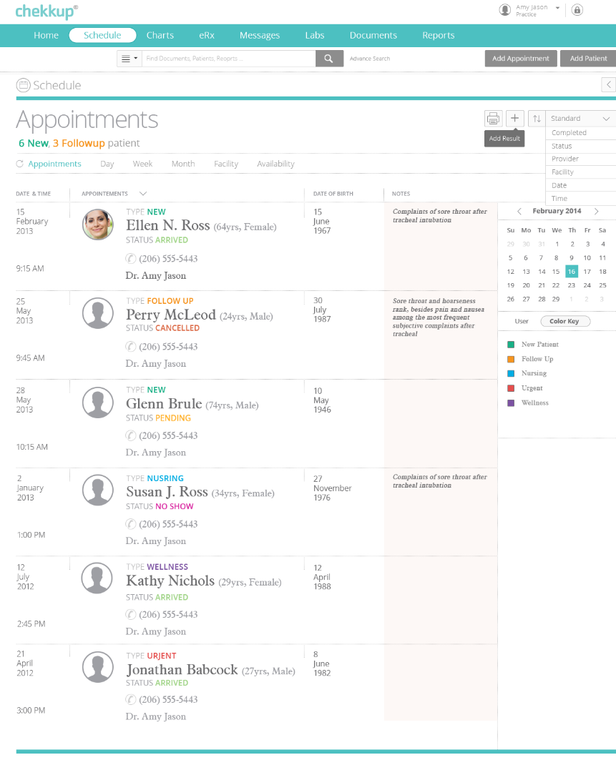
List Appointments
#Stages
This module allows the provider to view / schedule /re-schedule appointments.
The appointments can be view by,
Day wise
Week Wise
Facility Available
#Service Layer
#Business Layer
#Data Layer
URL

Slide 23
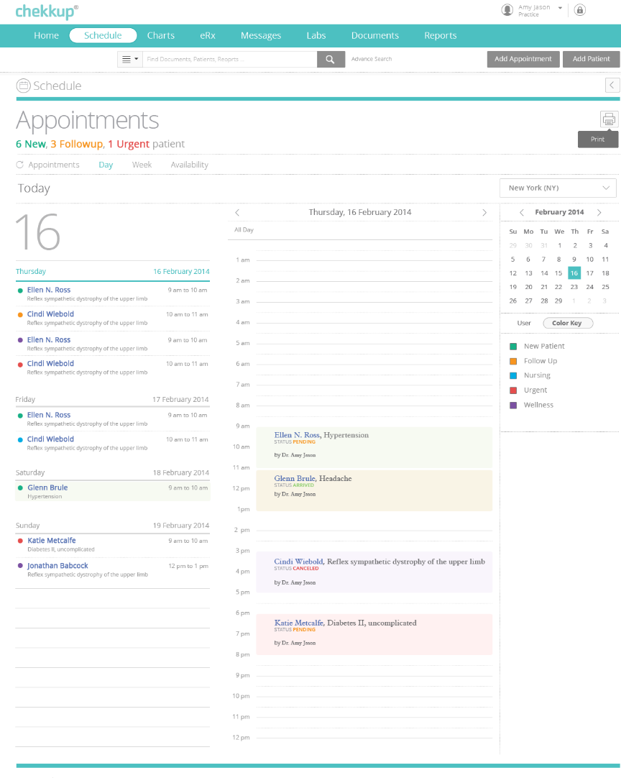
List Appointments
#Stages
Day Wise Appointments
#Service Layer
#Business Layer
#Data Layer
URL

Slide 24
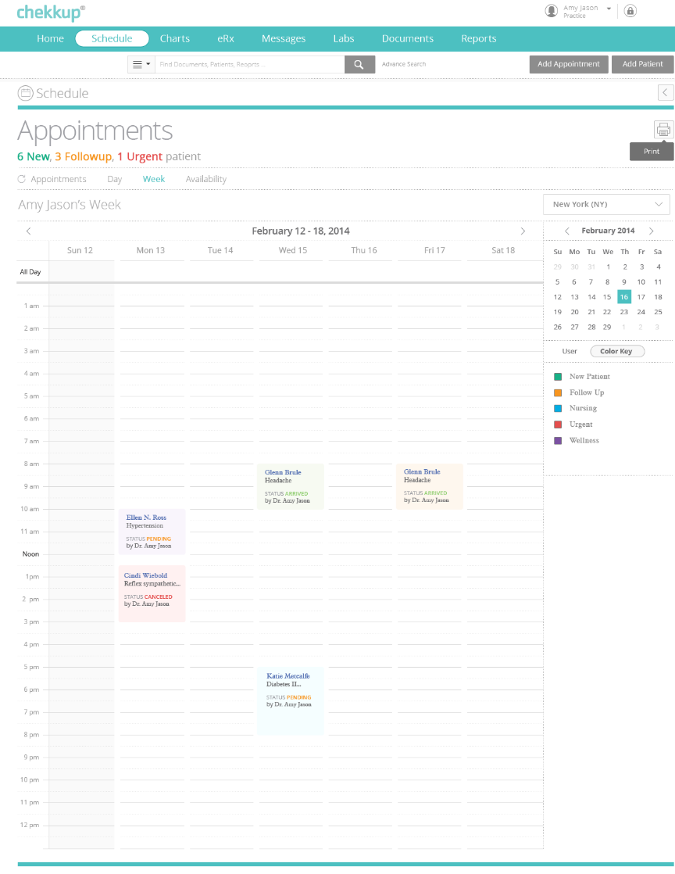
List Appointments
#Stages
Week Wise Appointments
#Service Layer
#Business Layer
#Data Layer
URL

Slide 25
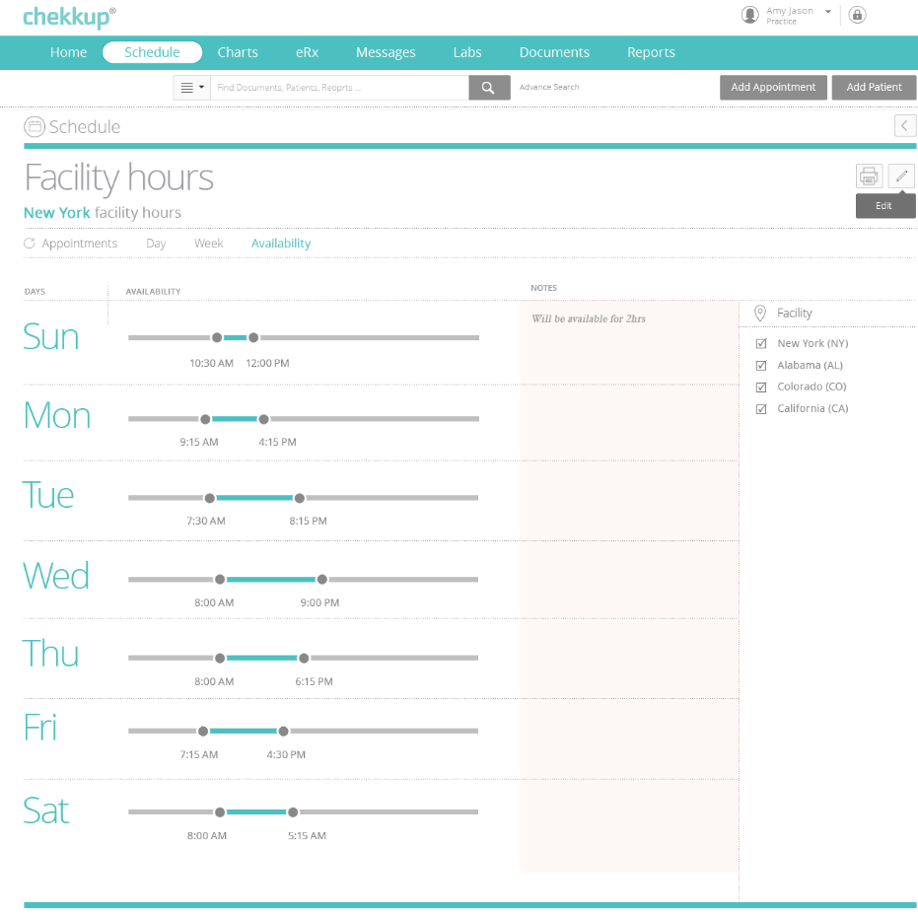
List Appointments
#Stages
Facility Available
#Service Layer
#Business Layer
#Data Layer
URL

Slide 26
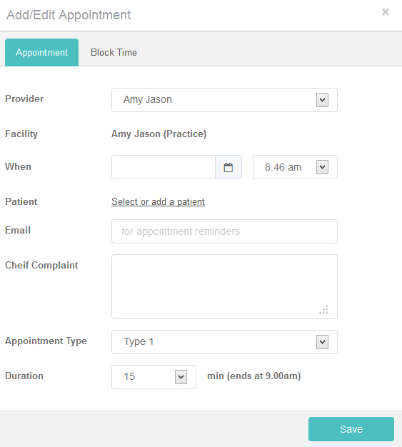
Add/Edit Appointments
#Stages
Enable appointment scheduling between the providers and the patients with appropriate color coding for facility hours, user appointments, and provider availability.
#Service Layer
#Business Layer
#Data Layer
URL

Slide 27
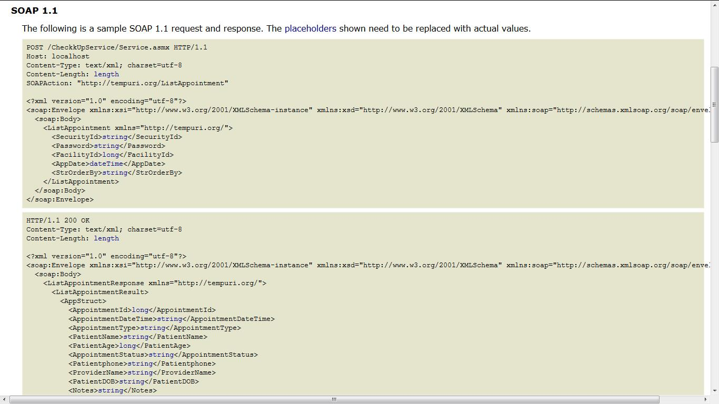
List Appointments – Service Layer
#Stages
View PDF
List appointments
Business Layer

Slide 28
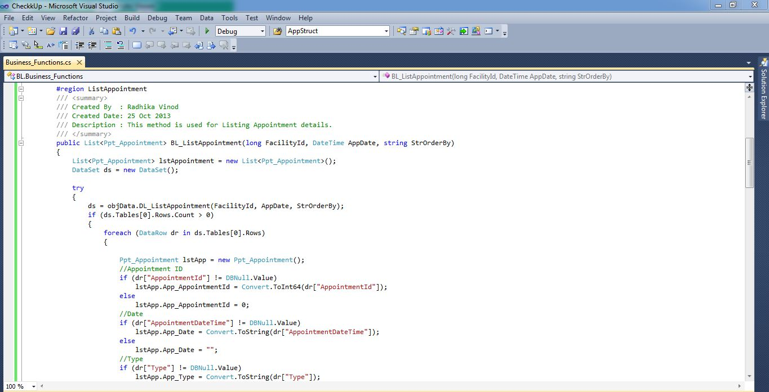
List Appointments – Business Layer
#Stages
Screen 1
Service Layer
BL Screen 2

Slide 29
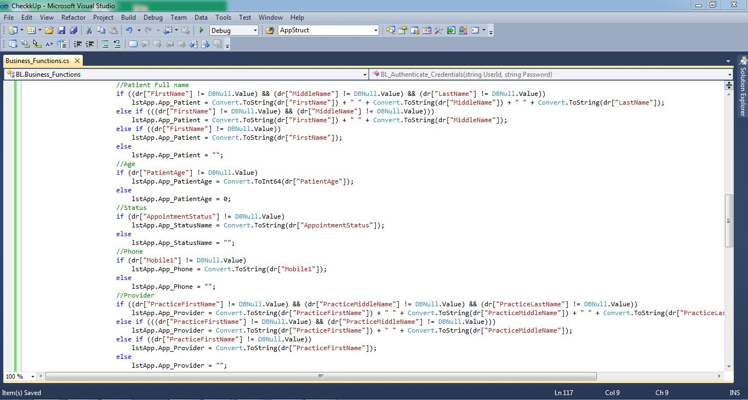
List Appointments – Business Layer
#Stages
Screen 2
BL Screen 1
BL Screen 3

Slide 30
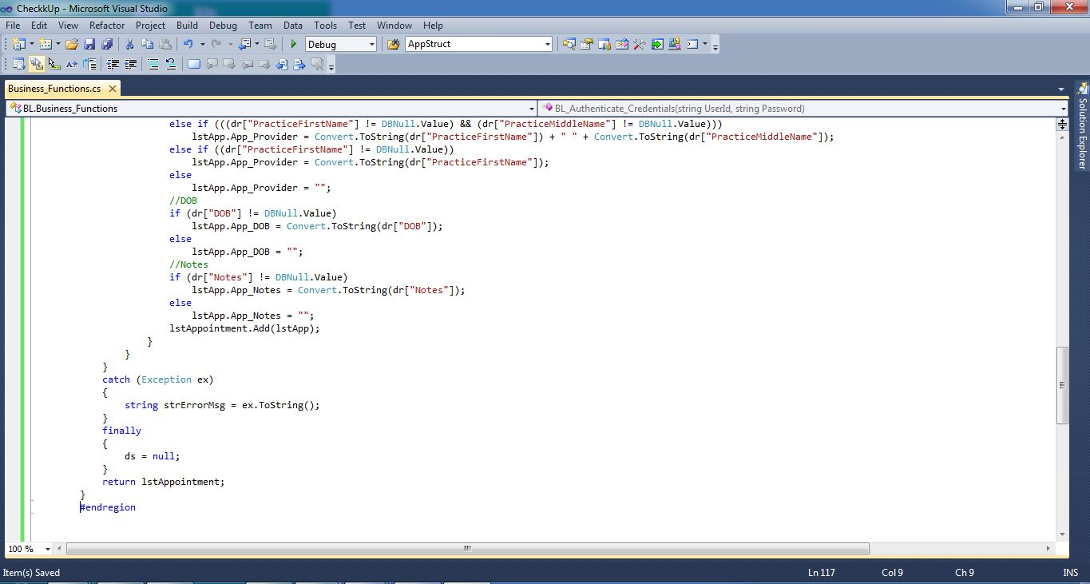
List Appointments – Business Layer
#Stages
Screen 3
BL Screen 2
Data Layer

Slide 31
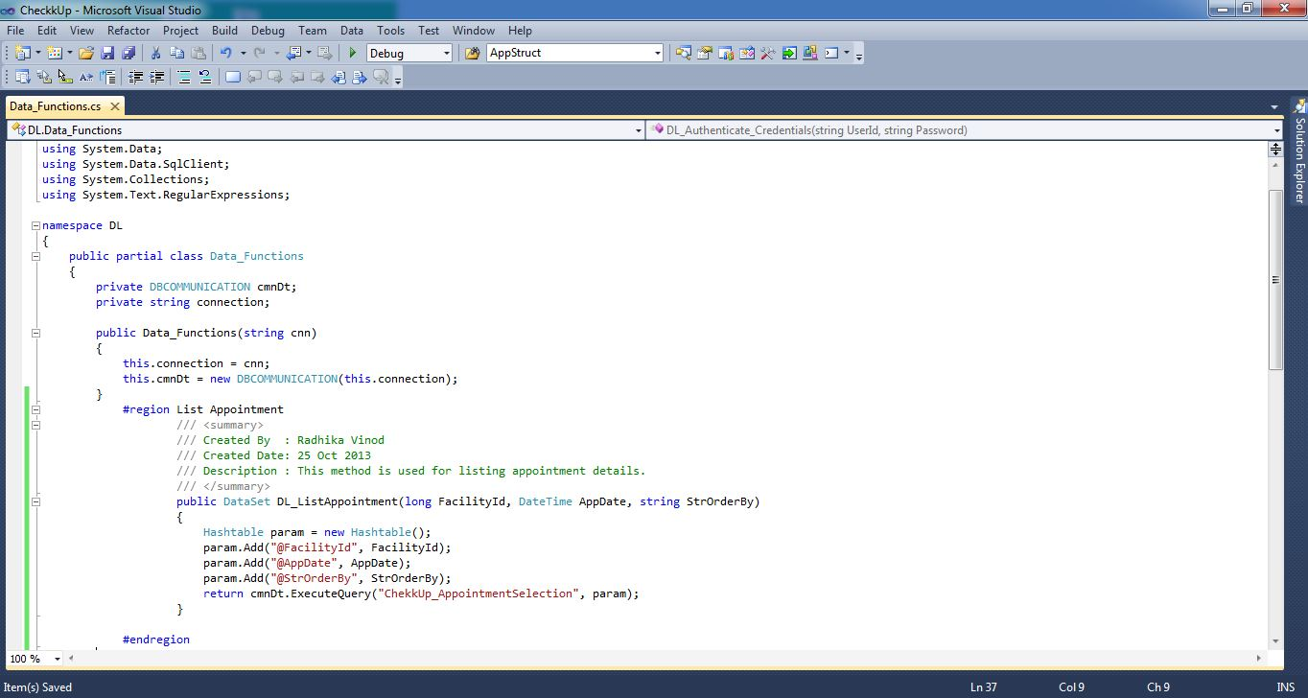
List Appointments – Data Layer
#Stages
BL Screen 3
Procedure

Slide 32
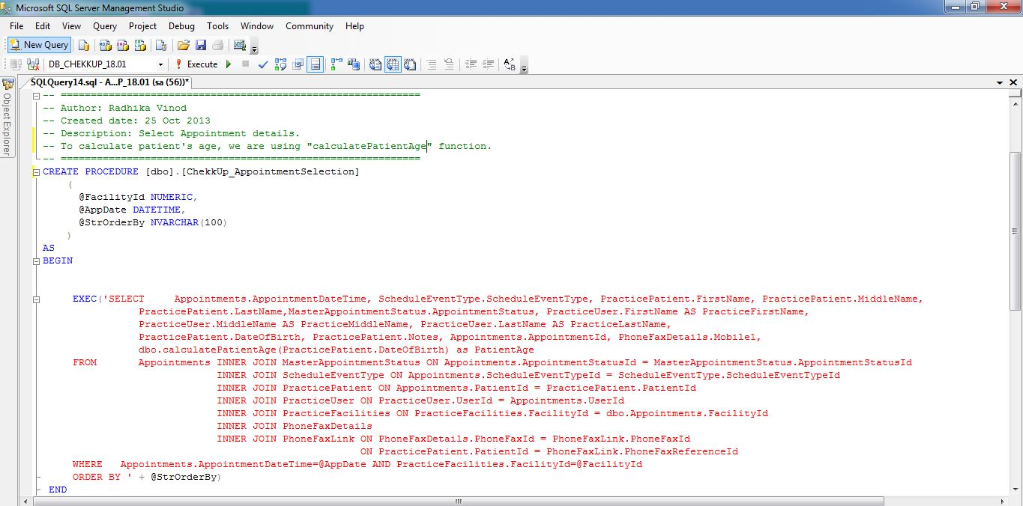
List Appointments – Procedure
#Stages
Screen 1
Data Layer
Procedure Screen 2

Slide 33
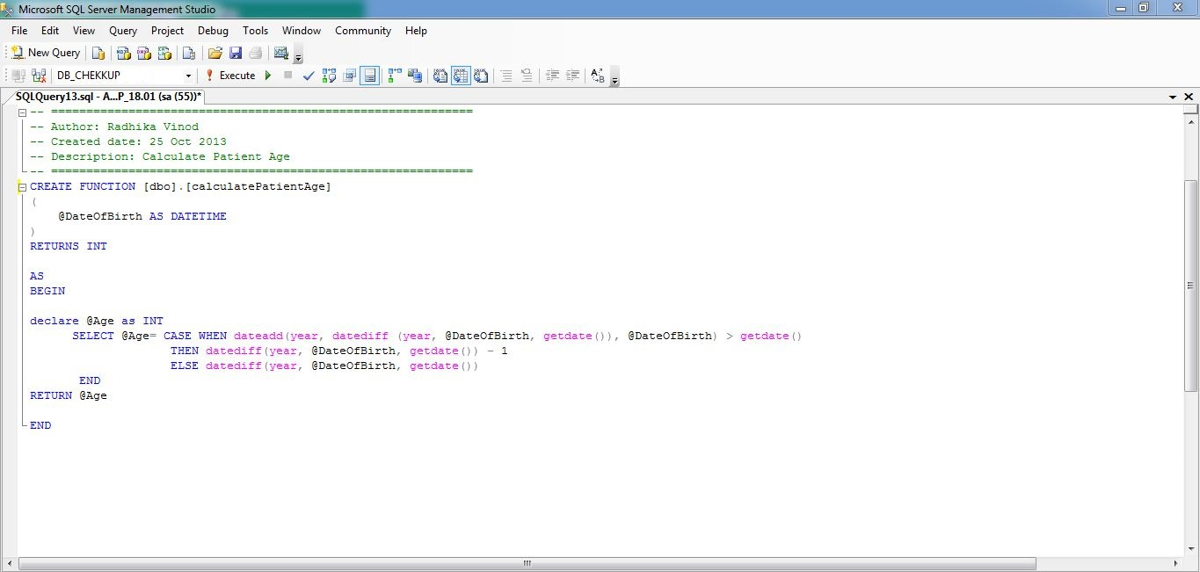
List Appointments – Procedure
#Stages
Screen 2
Procedure Screen 1
Scheduled DB Diagram

Slide 34
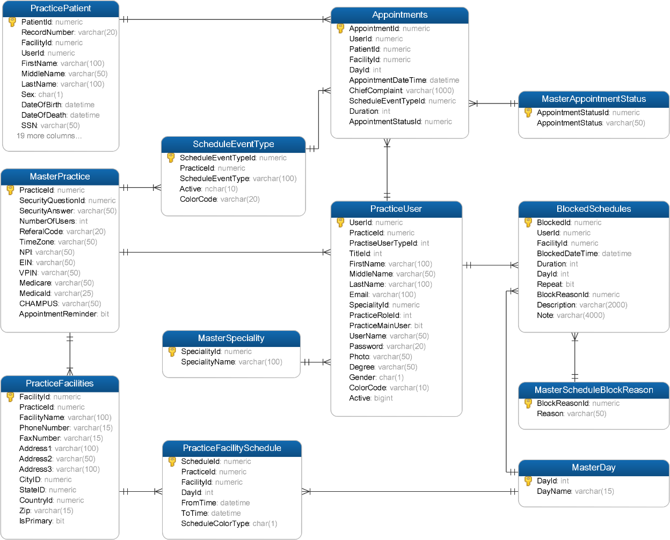
Schedule – DB Diagram
#Stages
View PDF
#Service Layer
#Business Layer
#Data Layer

Slide 35
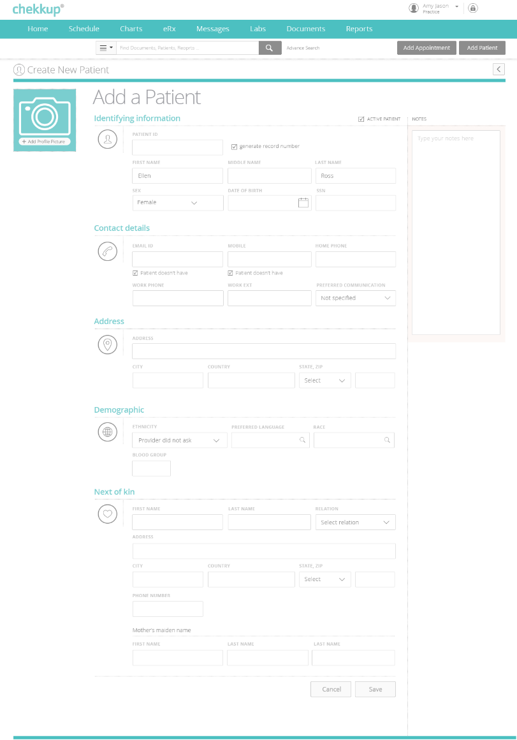
Add Patients
#Stages
Enable user to search and add new
patients and providers in the system. The search capabilities should be based on multiple fields such as Name, DOB, email, Phone etc
Identifying Information
Contact Details
Address
Demographics
Next of Kin
#Service Layer
#Business Layer
#Data Layer
URL

Slide 36
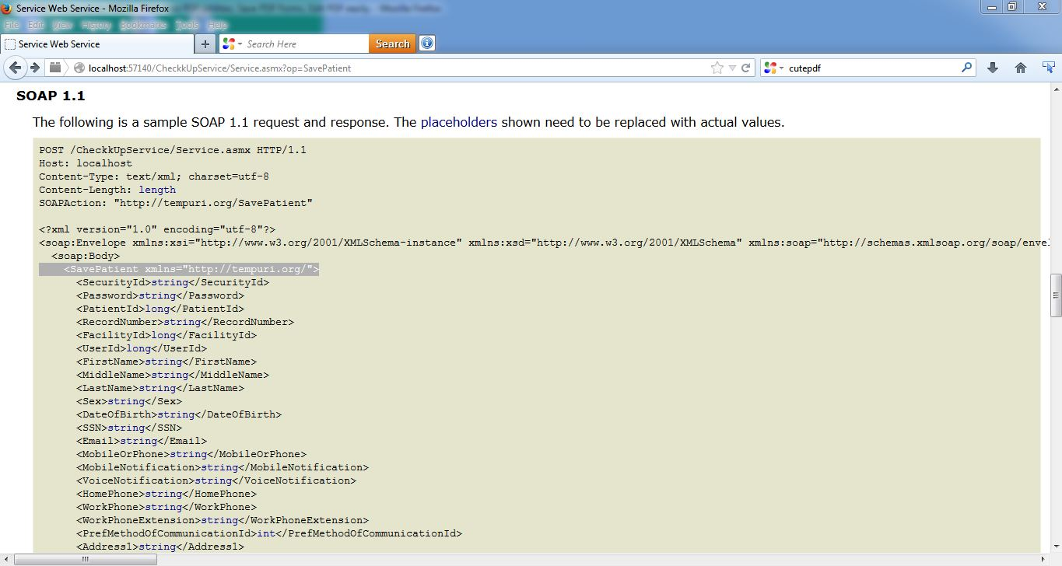
Add Patients – Service Layer
#Stages
Add Patient
Business Layer

Slide 37
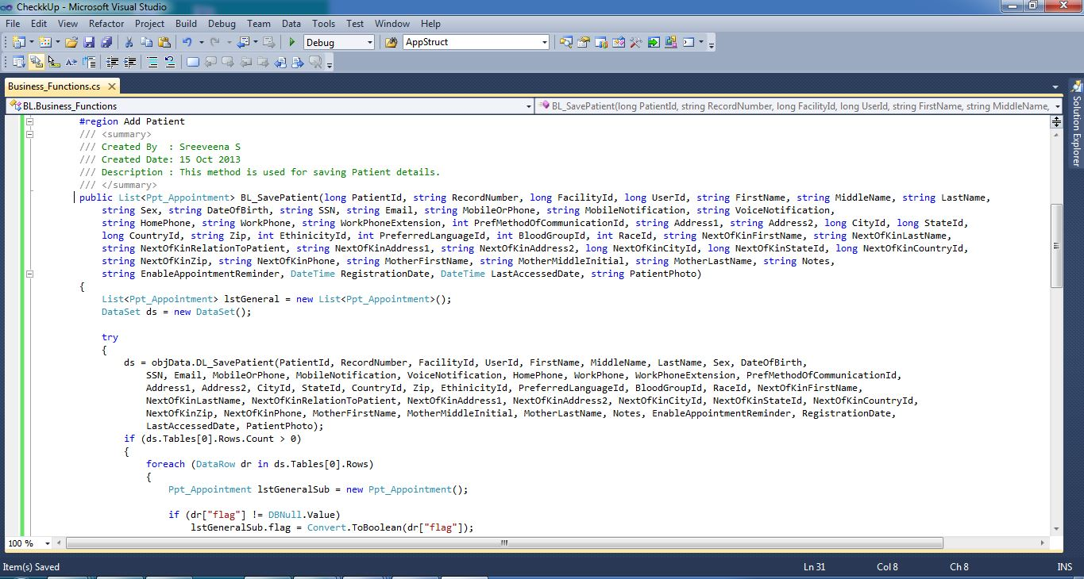
Add Patients - Business Layer
#Stages
Screen 1
Service Layer
BL Screen 2

Slide 38
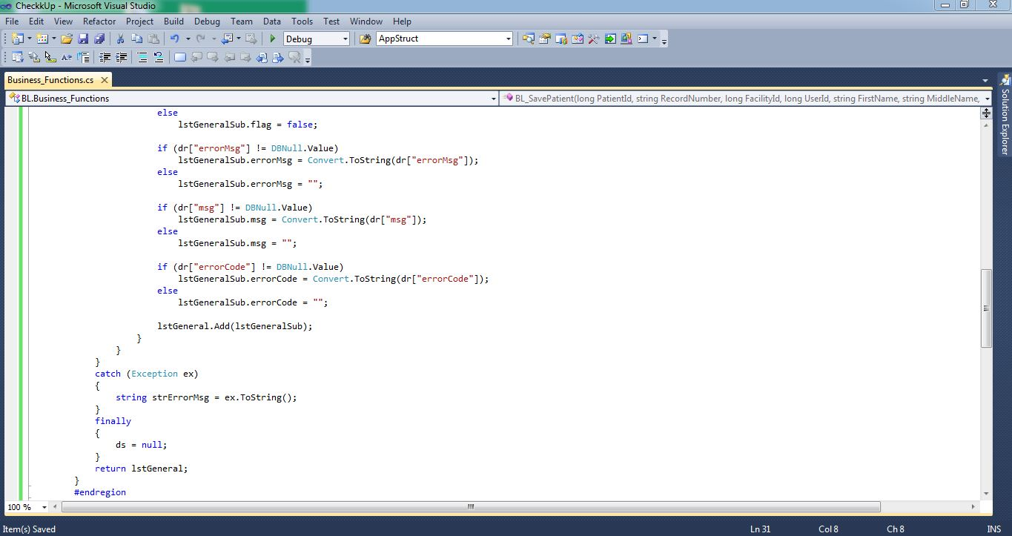
Add Patients - Business Layer
#Stages
Screen 2
BL Screen 1
Data Layer

Slide 39
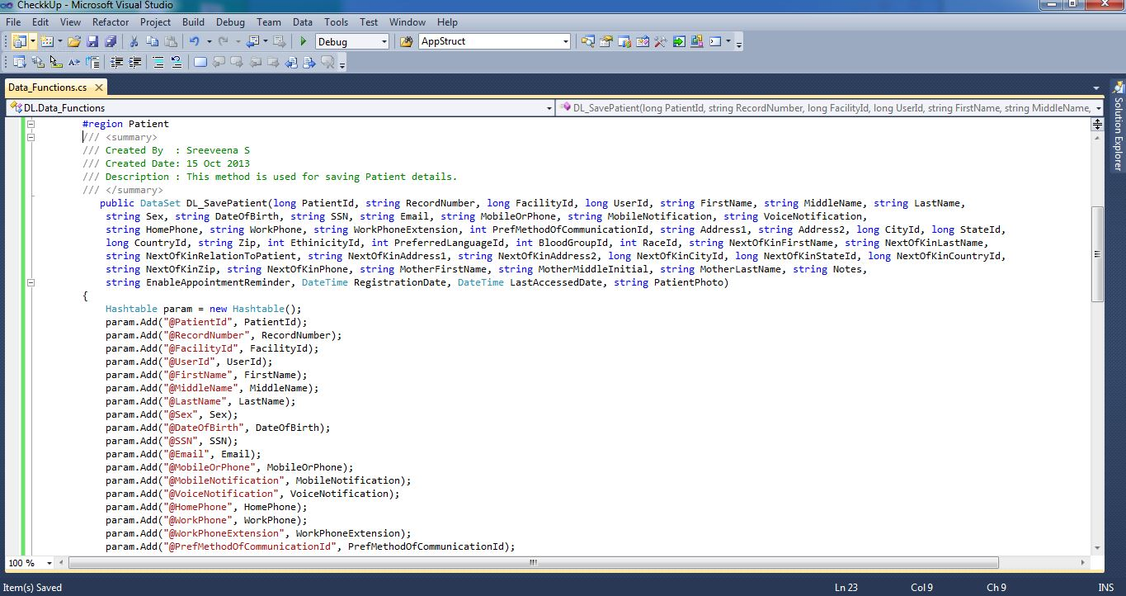
Add Patients – Data Layer
#Stages
Screen 1
BL Screen 2
DL Screen 2

Slide 40
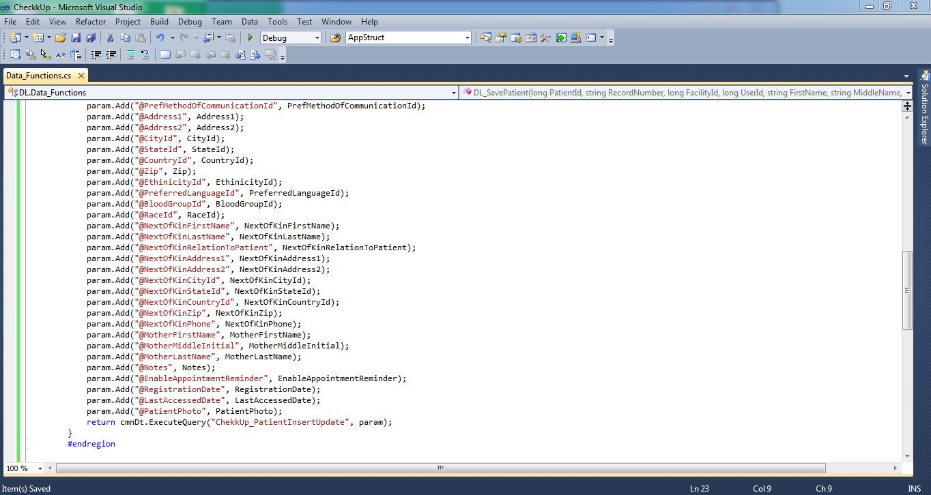
Add Patients – Data Layer
#Stages
Screen 2
DL Screen 1
Procedure

Slide 41
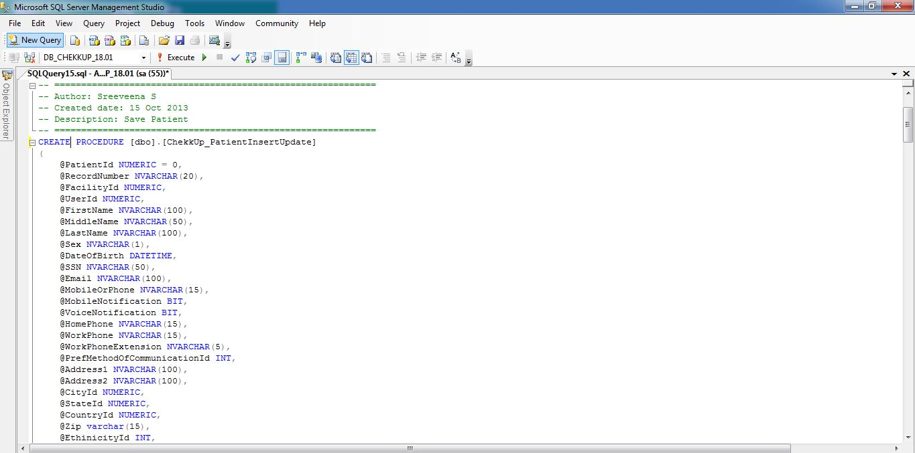
Add Patients – Procedure
#Stages
Screen 1
DL Screen 2
Procedure Screen 2

Slide 42
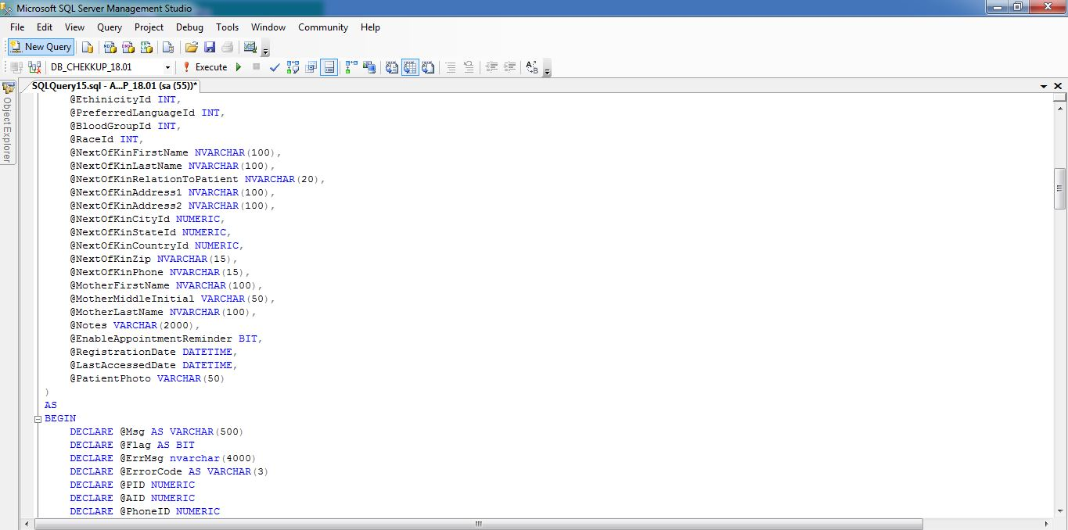
Add Patients – Procedure
#Stages
Screen 2
View PDF
Procedure Screen 1
Database Diagram

Slide 43
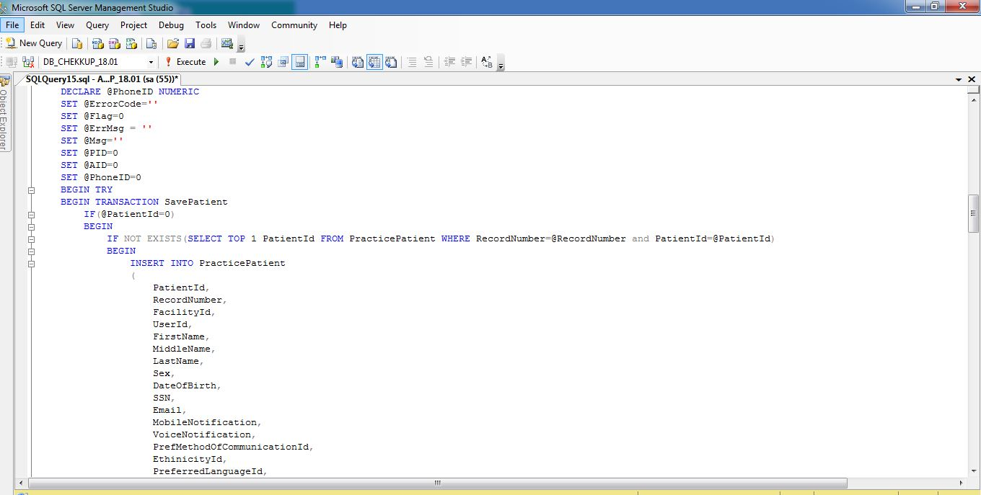
Add Patients – Procedure
#Stages
Screen 3

Slide 44
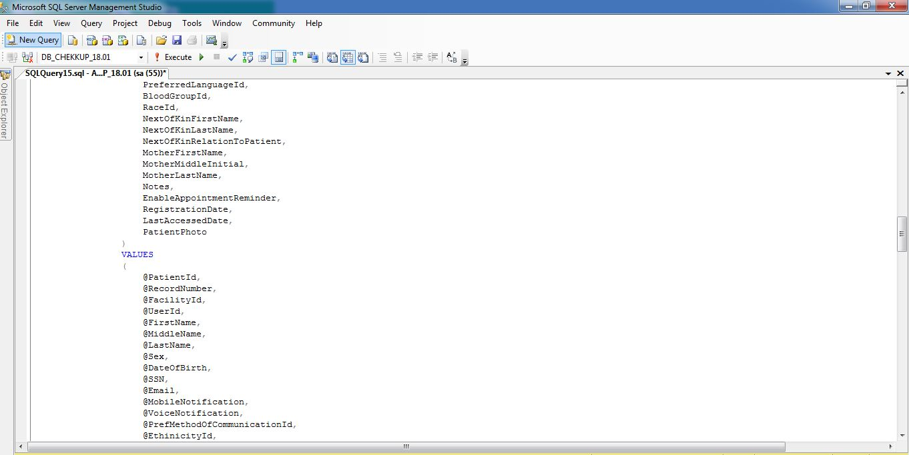
Add Patients – Procedure
#Stages
Screen 4

Slide 45
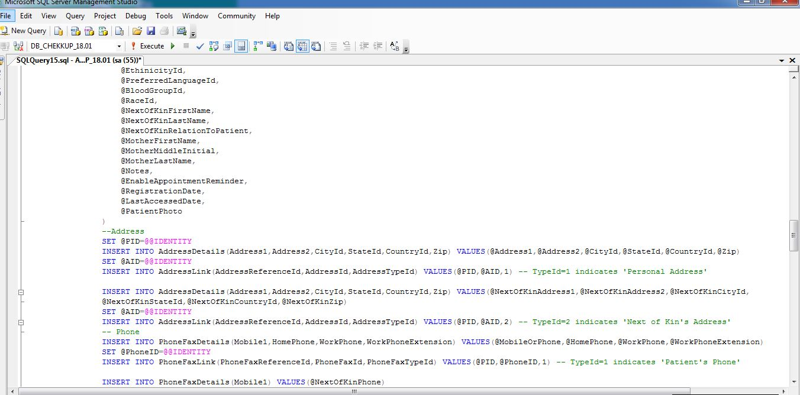
Add Patients – Procedure
#Stages
Screen 5

Slide 46
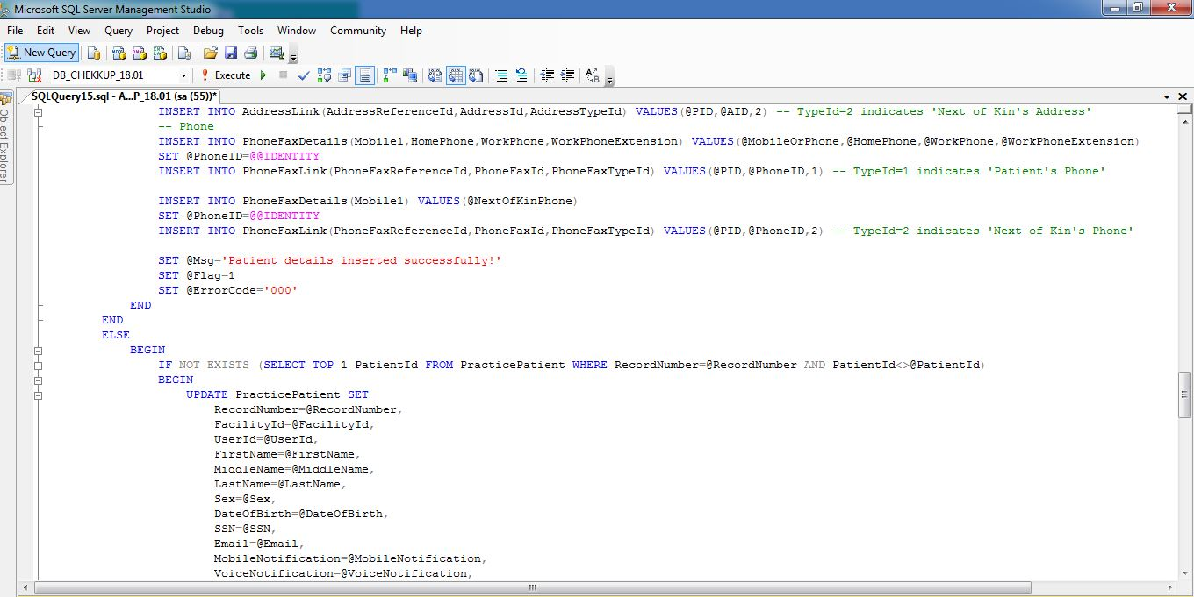
Add Patients – Procedure
#Stages
Screen 6

Slide 47
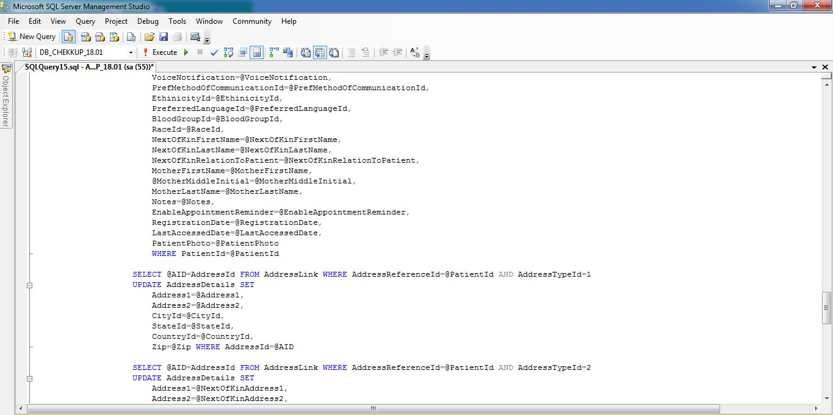
Add Patients – Procedure
#Stages
Screen 8

Slide 48
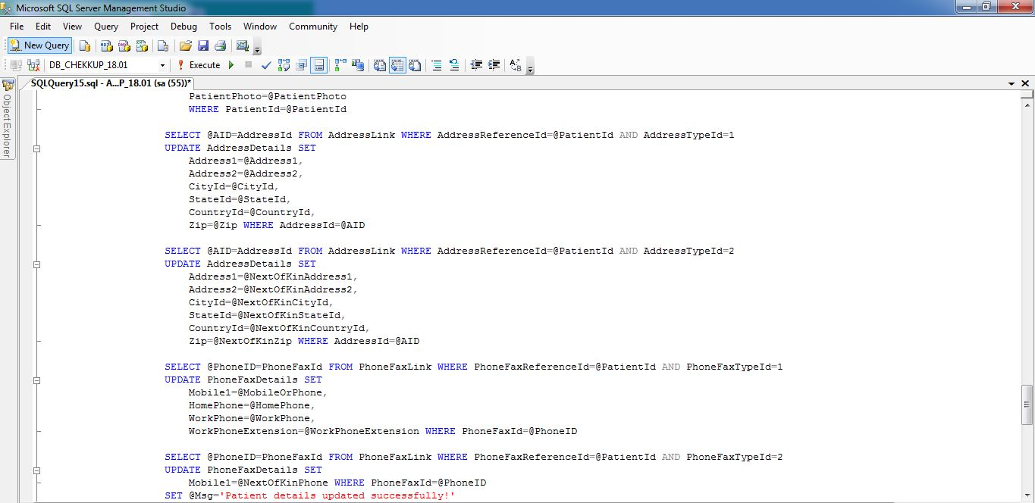
Add Patients – Procedure
#Stages
Screen 9

Slide 49
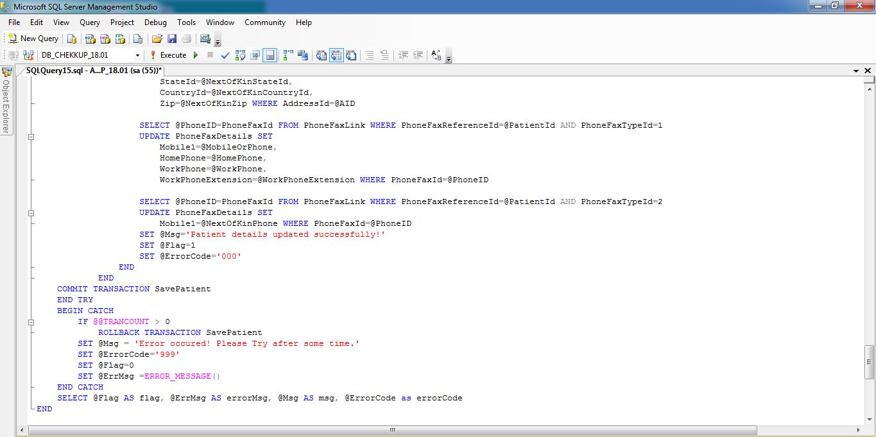
Add Patients – Procedure
#Stages
Screen 10

Slide 50
Schedule – DB Diagram
#Stages
View PDF
#Service Layer
#Business Layer
#Data Layer

Slide 51
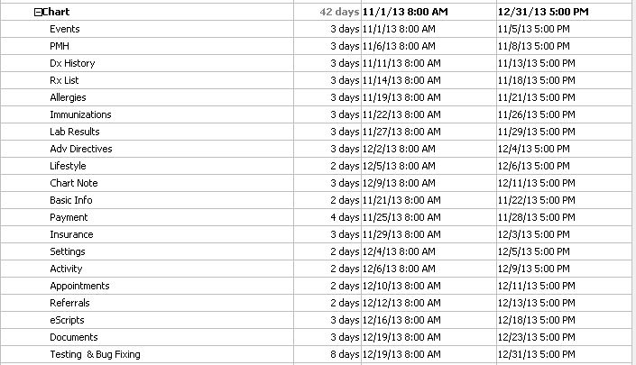
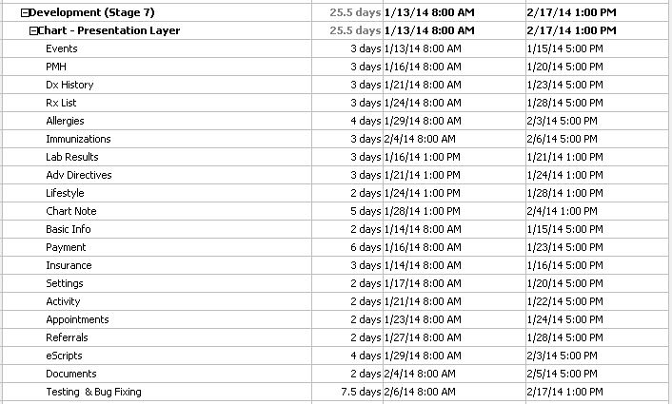
Chekkup Stages 2 - Charts - Plan
#Stages
Service Layer Plan
Presentation Layer Plan

Slide 52
Chekkup Stages 2 - Charts
#Stages
Electronic Health Records (EHR) has been proposed to prevent multiple medical charts, ensuring that a patient's entire medical history can be readily accessed. The Charting module contains the functionality for viewing and modifying the medical records of patients.
Immunization
Lab Result
Adv Directives
Life Style
Events
PMH
Dx History
Rx List
Allergies

Slide 53
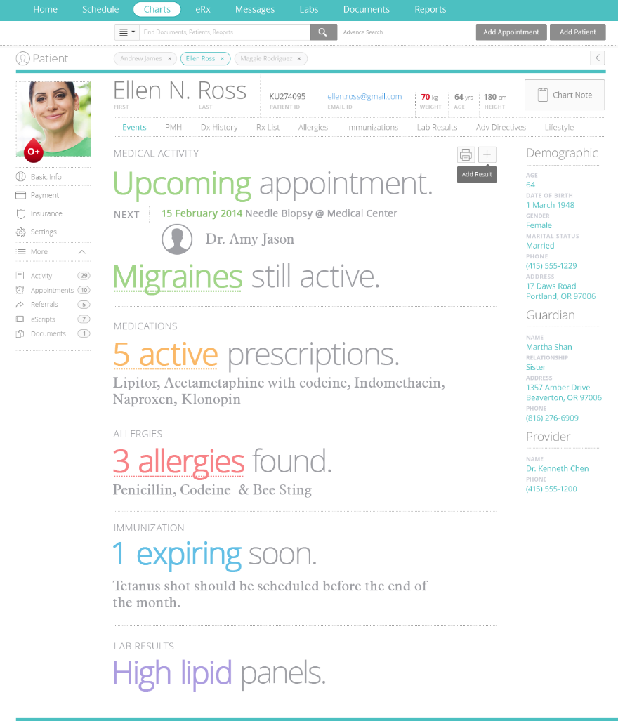
Charts - Events
#Stages
Face sheet allows quick access to patient’s medical history,
Upcoming Appointments
Medication
Allergies
Immunization
Lab Result
URL
#PMH
#Dx History
#Rx List
#Allergies
#Immunization
#Lab Result
#Adv Directives
#Life Style

Slide 54
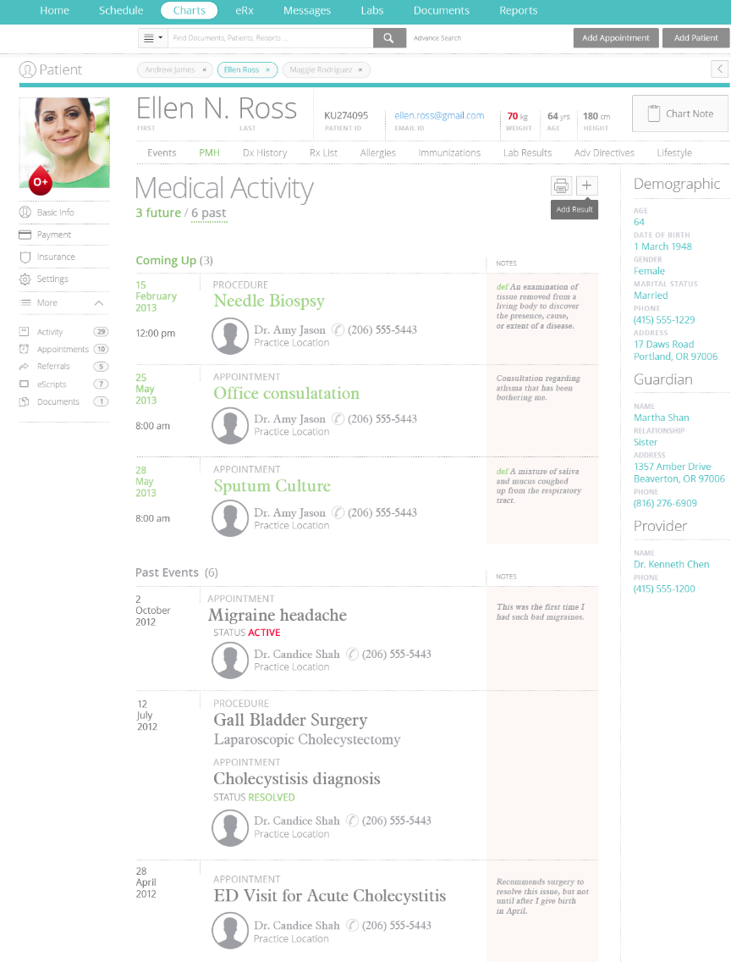
Charts - PMH
#Stages
PMH (Past Medical History) lists the total sum of a patient's health status prior to the presenting problem.
URL
#Events
#Dx History
#Rx List
#Allergies
#Immunization
#Lab Result
#Adv Directives
#Life Style

Slide 55
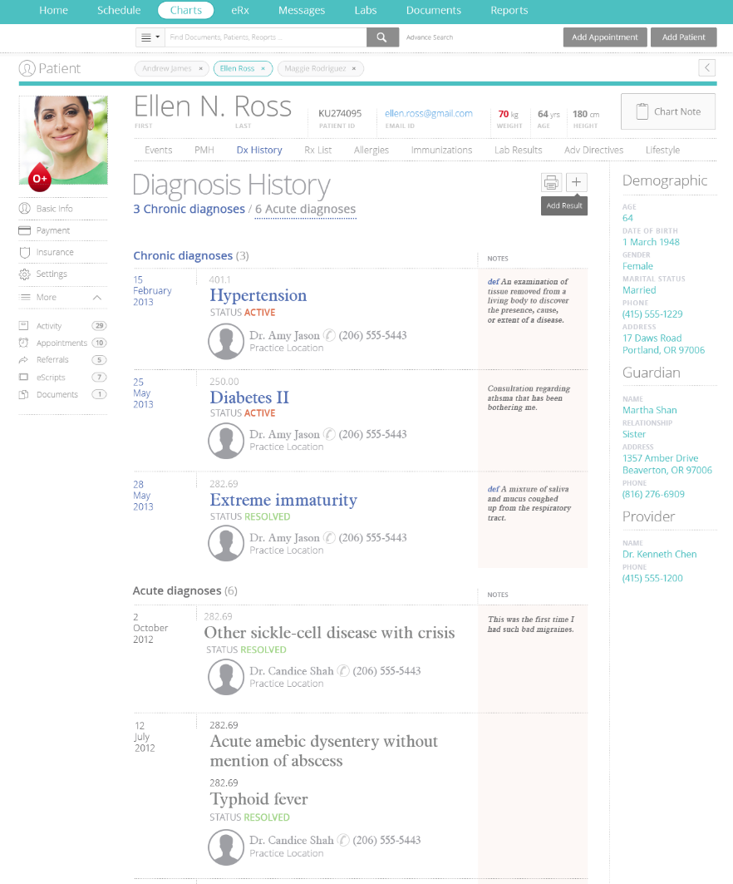
Charts – Dx History
#Stages
The diagnosis history of the patient includes,
Chronic Diagnosis
Acute Diagnosis
URL
#Events
#PMH
#Rx List
#Allergies
#Immunization
#Lab Result
#Adv Directives
#Life Style

Slide 56
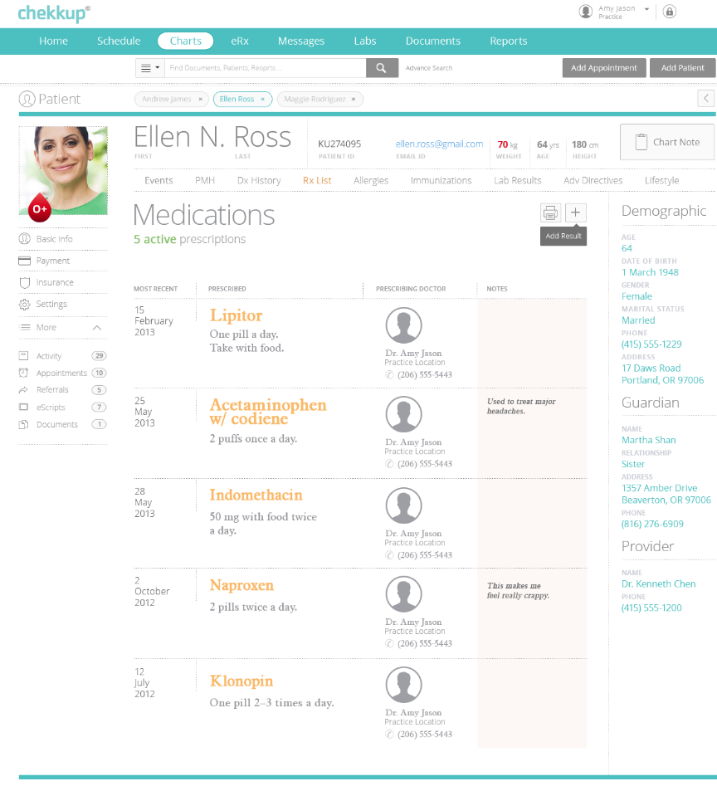
Charts – Rx List
#Stages
The medication list of the patient will be shown in Rx List. It has,
Current Medications
Past Medications
URL
#Events
#PMH
#Dx History
#Allergies
#Immunization
#Lab Result
#Adv Directives
#Life Style

Slide 57
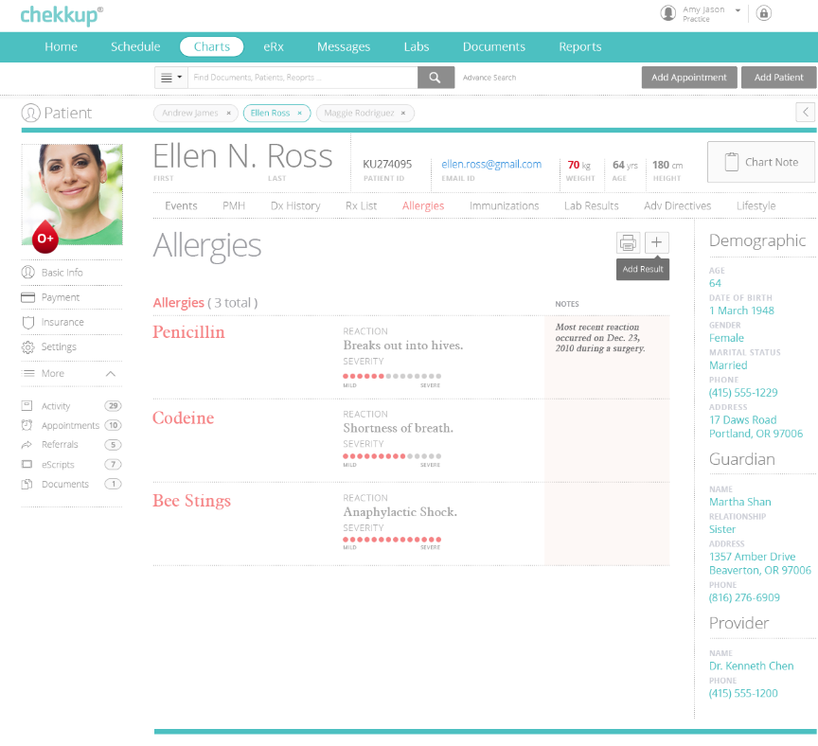
Charts – Allergies
#Stages
Allergy tab shows allergies suffered by a patient,
Drug Allergy
Food Allergy
Environmental Allergy
URL
#Events
#PMH
#Dx History
#Rx List
#Immunization
#Lab Result
#Adv Directives
#Life Style

Slide 58
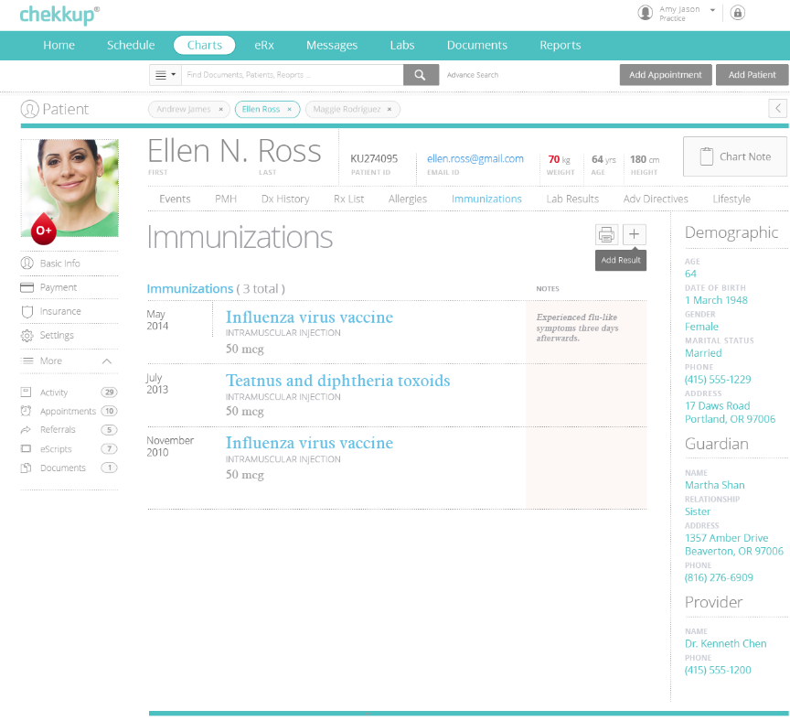
Charts – Immunization
#Stages
Here the vaccination the patient has taken will be listed.
URL
#Events
#PMH
#Dx History
#Rx List
#Allergies
#Lab Result
#Adv Directives
#Life Style

Slide 59
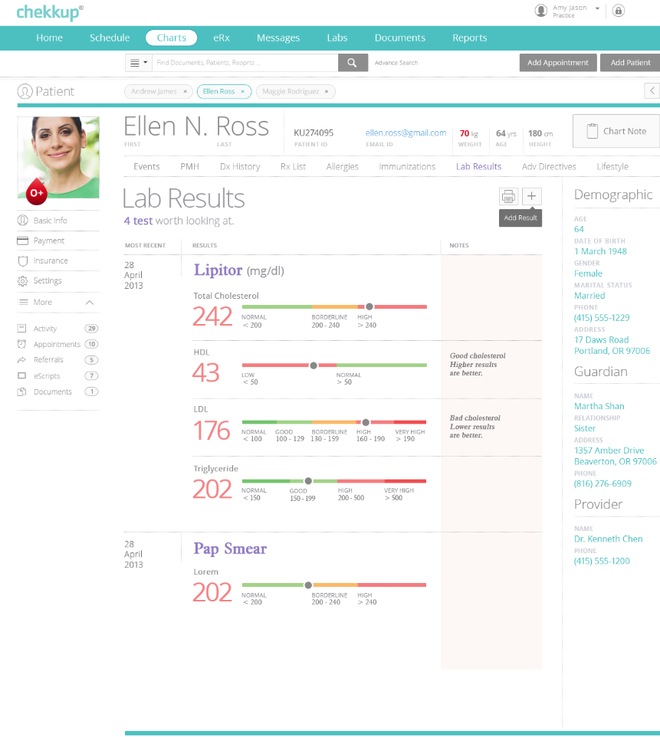
Charts – Lab Results
#Stages
Here results of lab tests taken for the patient will be listed.
URL
#Events
#PMH
#Dx History
#Rx List
#Allergies
#Immunization
#Adv Directives
#Life Style

Slide 60
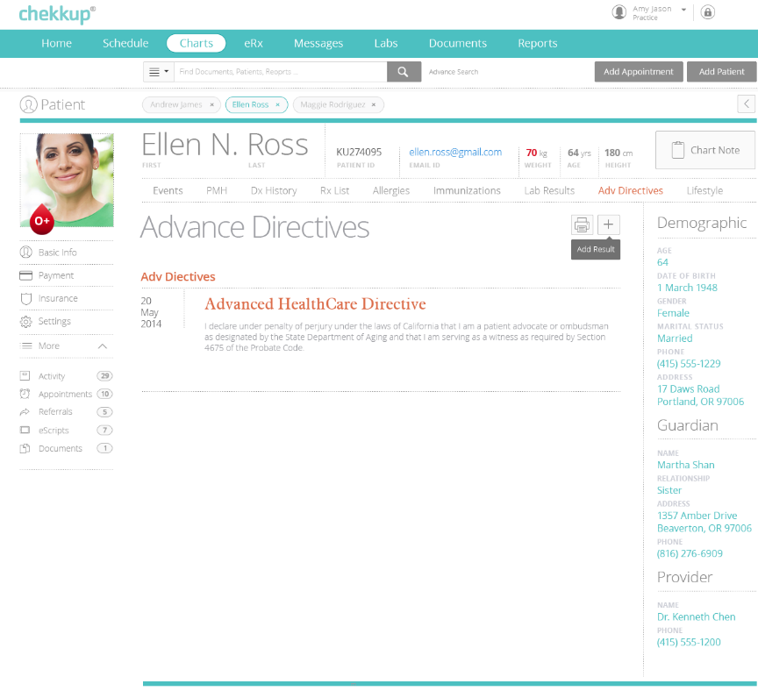
Charts – Adv Directives
#Stages
Advance health care directives a set of written instructions that a person gives, that specify what actions should be taken for their health, if they are no longer able to make decisions due to illness or incapacity.
URL
#Events
#PMH
#Dx History
#Rx List
#Allergies
#Immunization
#Lab Result
#Life Style

Slide 61

Charts – Life Style
#Stages
Here the details on lifestyle of patient will be listed.
URL
#Events
#PMH
#Dx History
#Rx List
#Allergies
#Immunization
#Lab Result
#Adv Directives

Slide 62

Charts – DB Diagram
#Stages
View PDF

Slide 63
Thank You

